Slide 1

ECE365: FPGA Audio Equalizer
By
Eswar Adithya (12311440) – B41
Sarath Kumar (12312393) – B42
Page 01

Slide 2
Introduction
This project demonstrates real-time digital signal processing using an FPGA platform.
MATLAB is used for FIR and IIR filter design, enabling precise control over filter characteristics.
The filter coefficients are exported into .coe format for seamless integration with FPGA design tools.
The FPGA is programmed to process audio signals via the onboard audio jack interface.
The project bridges the gap between software-based filter design and hardware-level signal processing.
Page 02

Slide 3
Components Required
Software: MATLAB R2021a,
Python 3.8.10,
Xilinx Vivado
Hardware: Nexys 4 FPGA board,
audio jack interface (3.5mm)
Page 03

Slide 4
Idea
Design FIR/IIR filters in MATLAB.
Convert coefficients to .coe file.
Import .coe into Vivado BRAM IP.
Create block design with audio interfaces.
Simulate and verify in Vivado.
Run synthesis, implementation, and bitstream generation.
Test real-time filtering on FPGA hardware.
Page 04

Slide 5
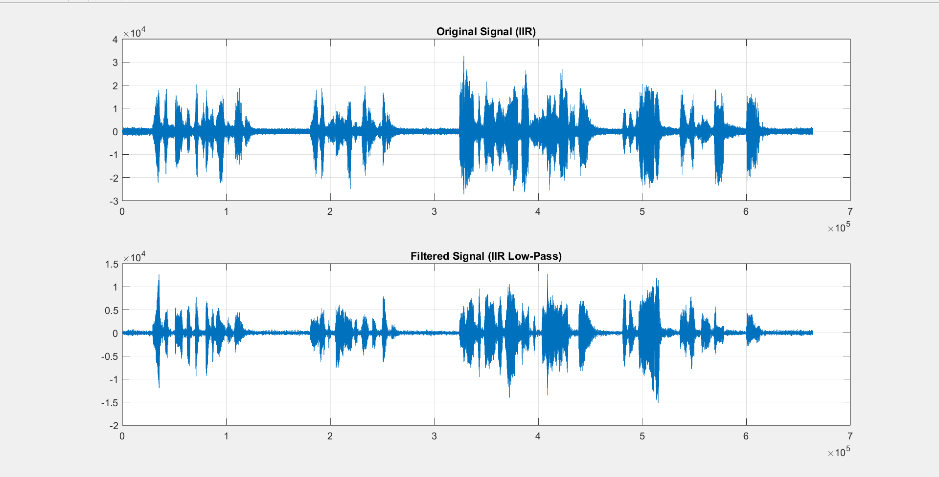
Filtering
Page 05

Slide 6
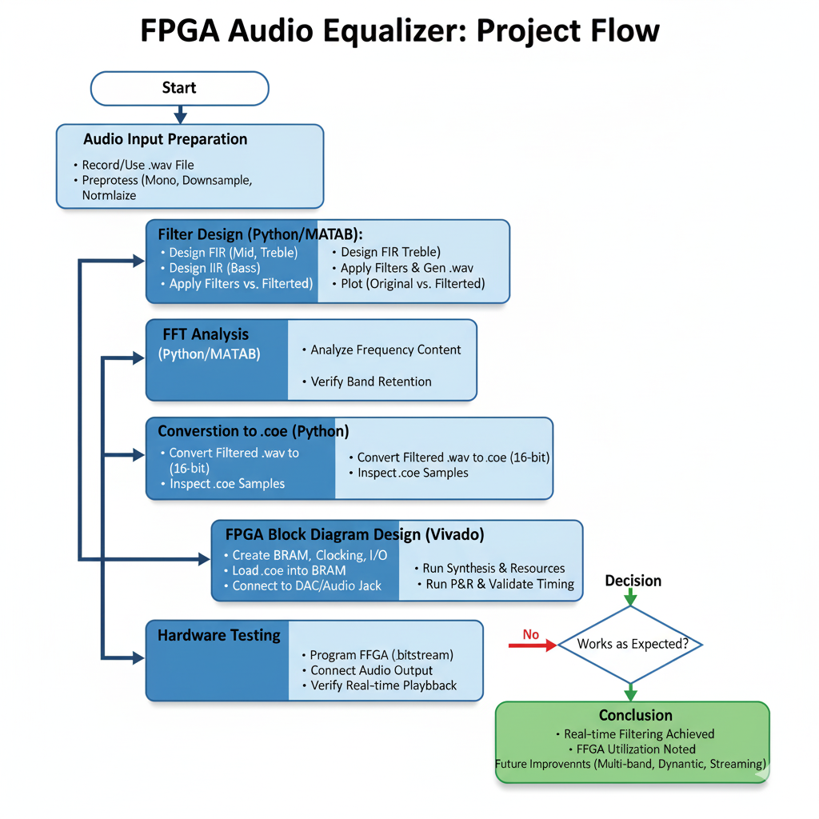
Page 06

Slide 7
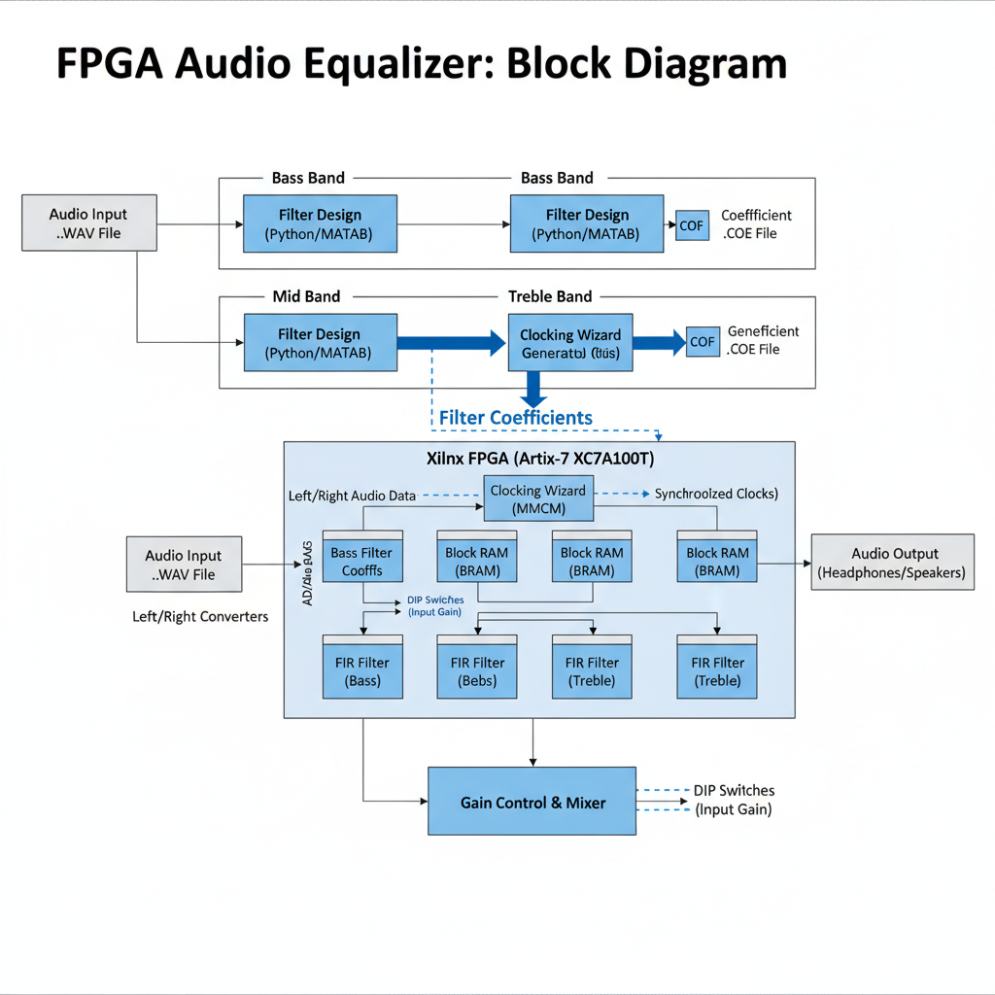
Page 07

Slide 8
Code
module top_audio (
input wire clk, // Nexys 4 100 MHz input
output wire aud_pwm, // PWM output to audio amplifier
output wire aud_sd // amplifier enable
);
// BRAM address + sample
reg [15:0] audio_addr = 16'd0;
wire [7:0] audio_sample; // raw BRAM output
reg [7:0] audio_sample_reg = 8'd0; // captured sample used by PWM
// Clocking: use Clocking Wizard to produce 25 MHz
wire clk_25mhz;
wire clk_locked; // not used, but good to have
// Divider for sample rate: 25 MHz -> ~44.1 kHz
// DIVIDER = floor(25_000_000 / 44100) = 567 (so tick every 567 cycles)
localparam integer DIVIDER = 25_000_000 / 44100; // = 567
reg [15:0] div_cnt = 16'd0;
reg sample_tick = 1'b0;
reg sample_tick_d = 1'b0; // delayed tick for read latency handling
// PWM counter (8-bit)
reg [7:0] pwm_counter = 8'd0;
Page 08

Slide 9
Code
// instantiate your clock wizard IP (must be present in project)
clk_wiz_0 clk_wiz_inst (
.clk_in1(clk),
.clk_out1(clk_25mhz),
.reset(1'b0),
.locked(clk_locked)
);
// instantiate BRAM (use the name you generated: audio_bram)
// BRAM clka must be a real clock net (clk_25mhz)
audio_bram audio_bram_inst (
.clka(clk_25mhz),
.ena(1'b1),
.wea(1'b0),
.addra(audio_addr),
.dina(8'd0),
.douta(audio_sample)
);
Page 9

Slide 10
Code
// increment address on the tick (one increment per sample)
if (sample_tick) begin
if (audio_addr == 16'hFFFF)
audio_addr <= 16'h0000;
else
audio_addr <= audio_addr + 16'd1;
end
// capture BRAM output one cycle after presenting address
if (sample_tick_d) begin
audio_sample_reg <= audio_sample;
end
// pwm counter runs continuously
pwm_counter <= pwm_counter + 8'd1;
end
// pwm output: compare running counter to captured sample
assign aud_pwm = (pwm_counter < audio_sample_reg);
assign aud_sd = 1'b1; // keep amp enabled
endmodule
always @(posedge clk_25mhz) begin
// divider
if (div_cnt == (DIVIDER - 1)) begin
div_cnt <= 16'd0;
sample_tick <= 1'b1;
end else begin
div_cnt <= div_cnt + 16'd1;
sample_tick <= 1'b0;
end
// delay tick so we can capture BRAM output
(read latency = 1)
sample_tick_d <= sample_tick;
Page 10

Slide 11
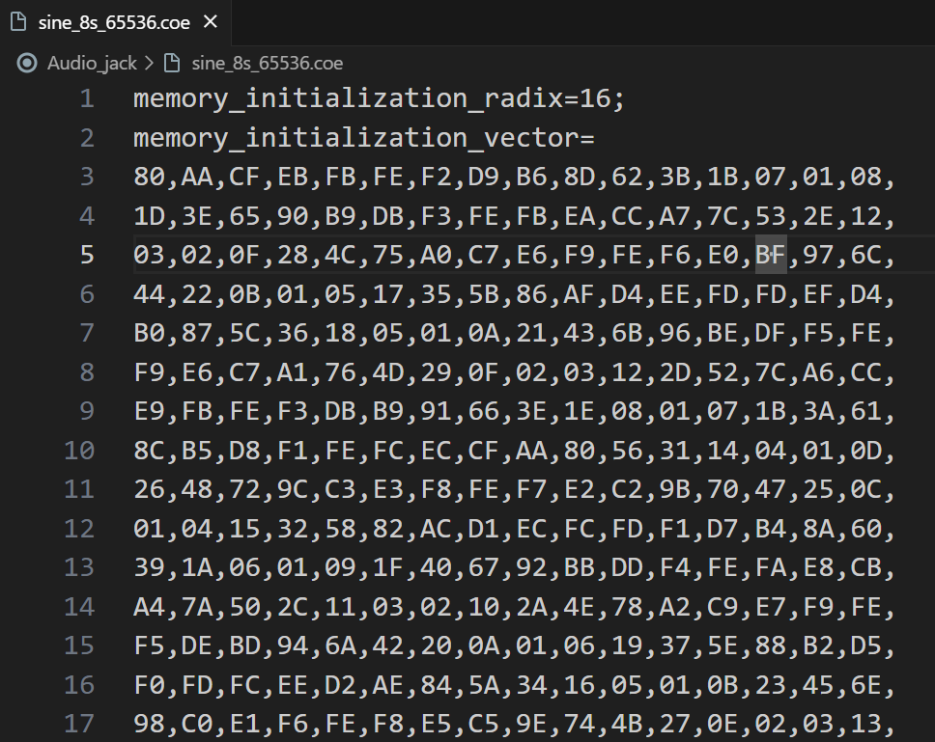
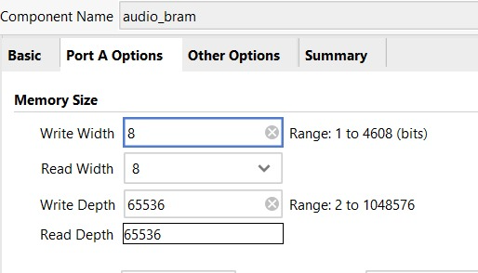
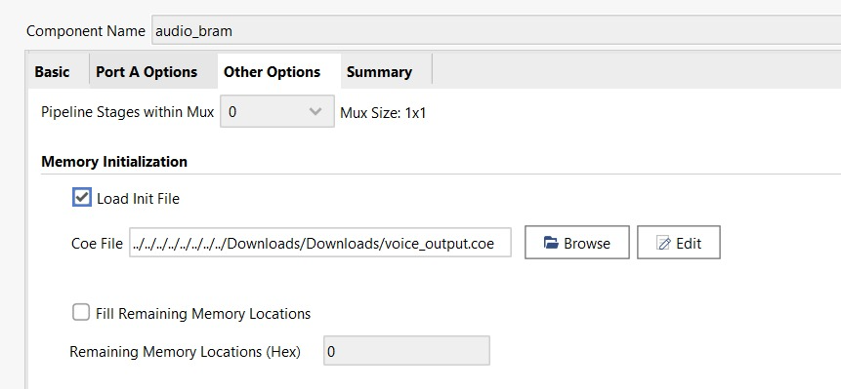
Memory Size for IP BRAM
Loading .coe into 32-bit 16 - IP BRAM’s
Conversion into .coe file
Page 11

Slide 12
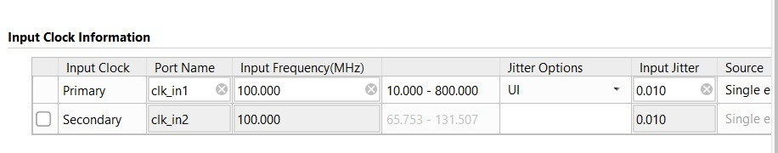
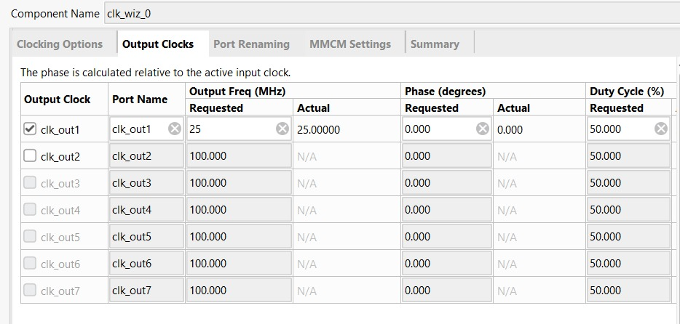
Configuration for i/p clk_wzd
Configuration for o/p clk_wzd
Page 12

Slide 13
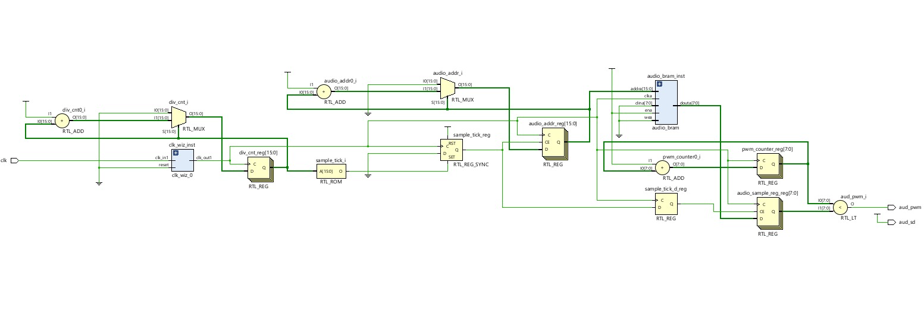
Schematic
Page 13

Slide 14
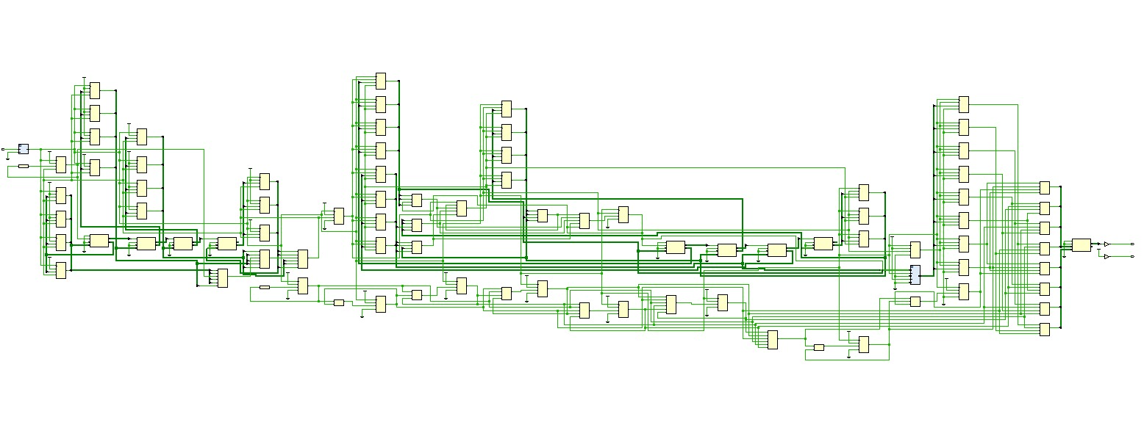
Synthesis
Page 14

Slide 15
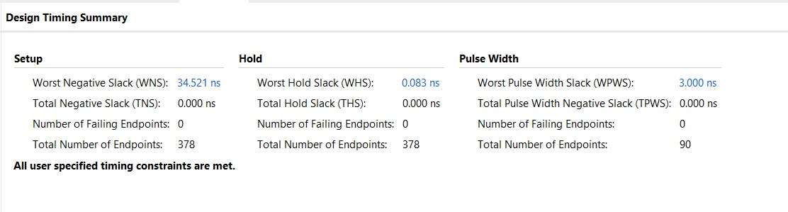
Timing Summary
Page 15

Slide 16
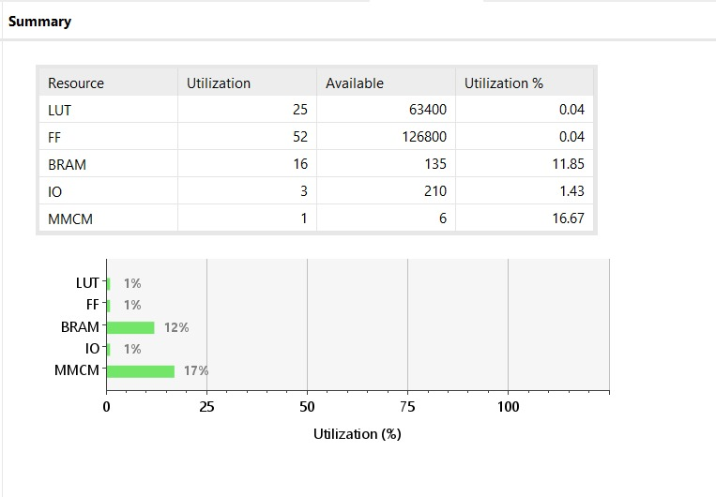
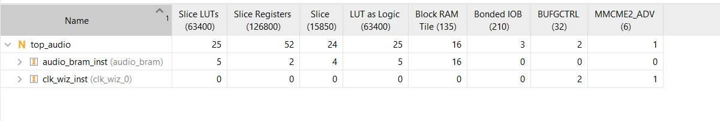
Resource Utilization
Page 16

Slide 17
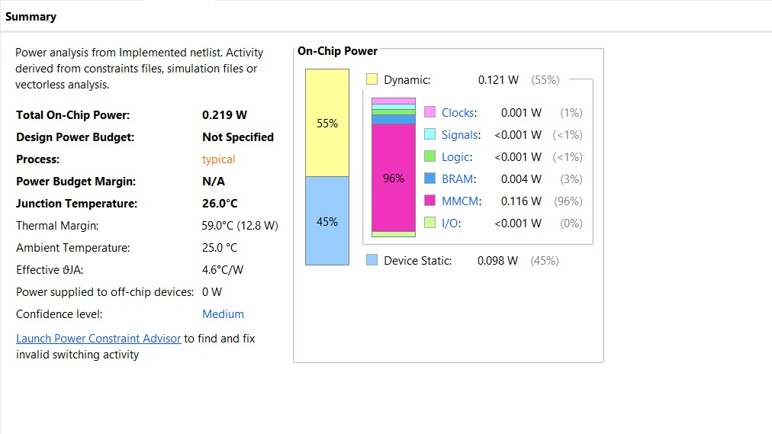
Power Usage
Page 17

Slide 18
Conclusion
Successfully implemented FIR and IIR digital filters on FPGA.
Demonstrated real-time audio signal processing using MATLAB and Vivado.
Showed complete workflow: MATLAB design → COE generation → FPGA implementation.
Verified functionality through simulation, synthesis, and hardware testing.
Project proves FPGA as an efficient platform for DSP applications.
Page 18

Slide 19
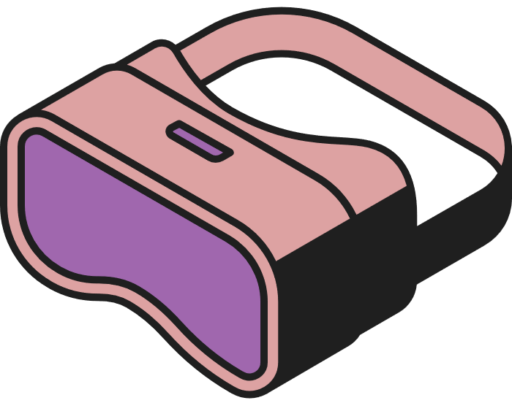
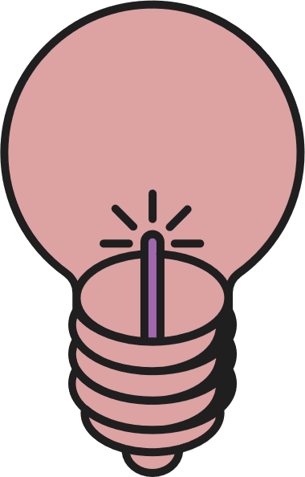


THANK YOU
Page 19

